Slide 1
4. Optimisation
Lecture 4
2024/25 sophie.stevens@bristol.ac.uk

Slide 2
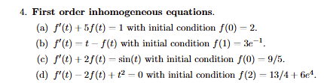
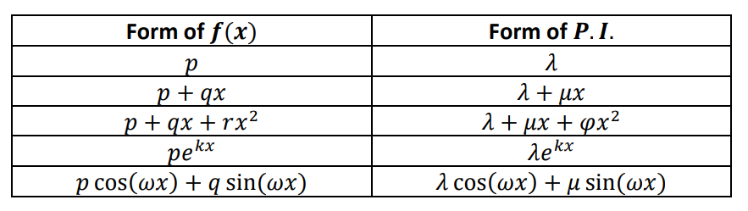
Workshop 3 summary:
Check your work!
https://pmt.physicsandmathstutor.com/download/Maths/A-level/Further/Core-Pure/Edexcel/CP2/Cheat-Sheets/Ch.7%20Methods%20in%20Differential%20Equations.pdf

Slide 3
What we’ll cover today:
Optimising functions via calculus
Gradient descent method
Simplex method

Slide 4
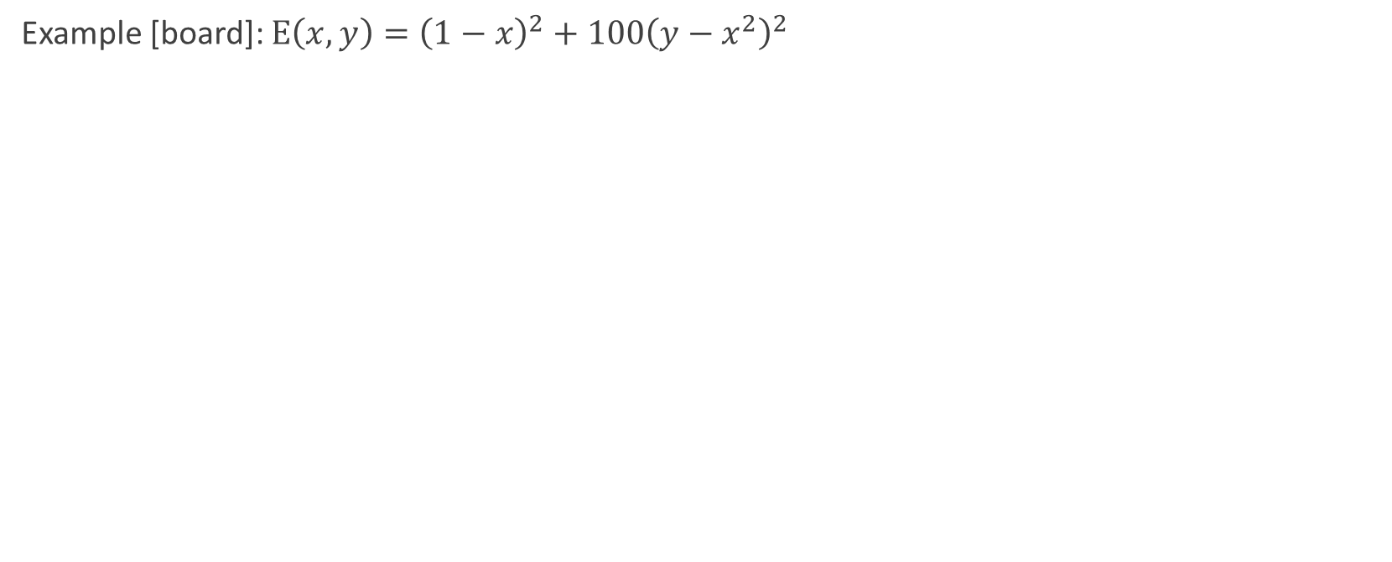
We can optimise with calculus
Example [board]: $E\left(x,y\right)={\left(1−x\right)}^{2}+100{\left(y−x^{2}\right)}^{2}$

Slide 5
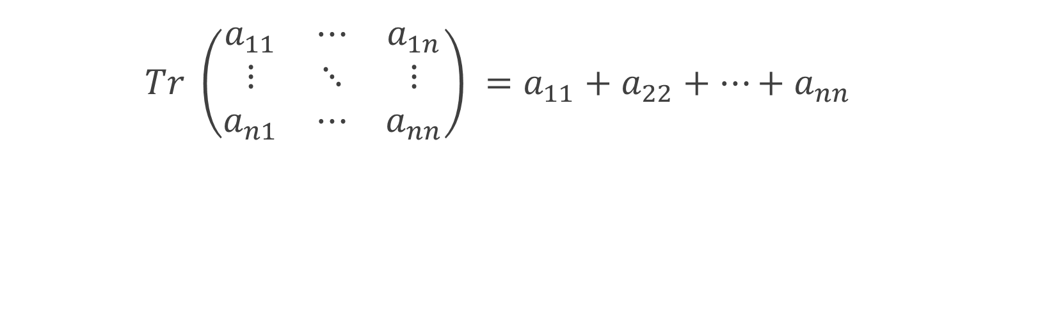
Aside: how to calculate the trace
$$Tr \left(\begin{matrix}a_{11} & ⋯ & a_{1n} \\ ⋮ & ⋱ & ⋮ \\ a_{n1} & ⋯ & a_{nn}\end{matrix}\right) =a_{11}+a_{22}+…+a_{nn}$$

Slide 6
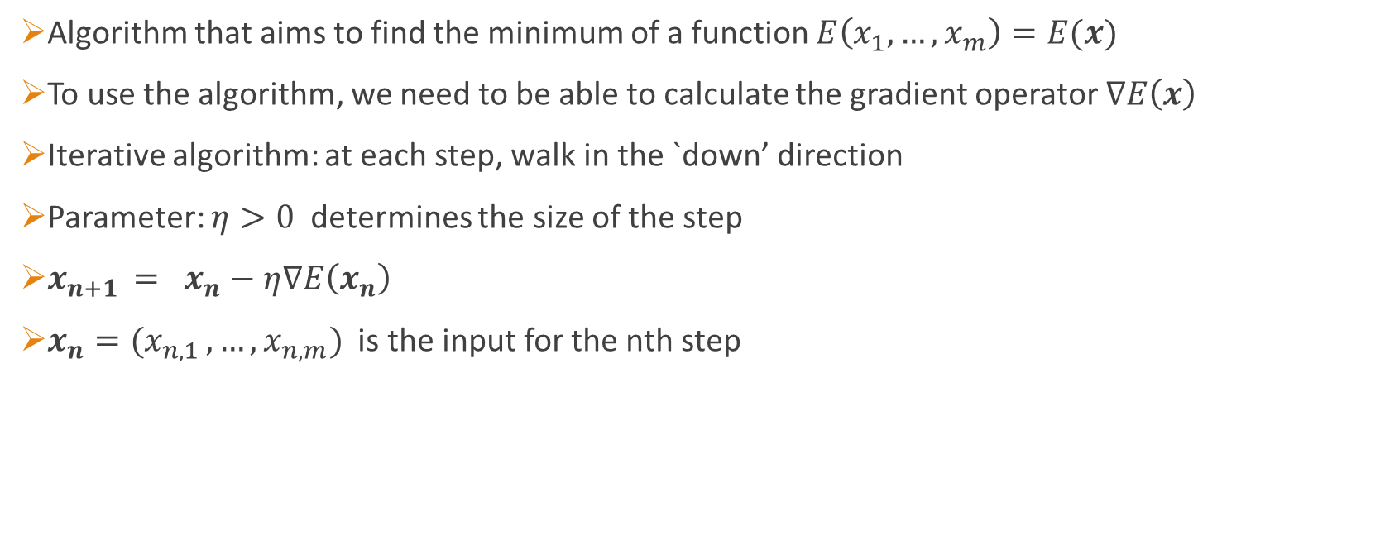
Gradient descent
Algorithm that aims to find the minimum of a function $E\left(x_{1}, …, x_{m}\right)=E(x)$
To use the algorithm, we need to be able to calculate the gradient operator $∇E\left(x\right)$
Iterative algorithm: at each step, walk in the `down’ direction
Parameter: $η>0$ determines the size of the step
$x_{n+1 }= x_{n}−η∇E\left(x_{n}\right)$
$x_{n}=(x_{n,1 }, …, x_{n,m})$ is the input for the nth step

Slide 7
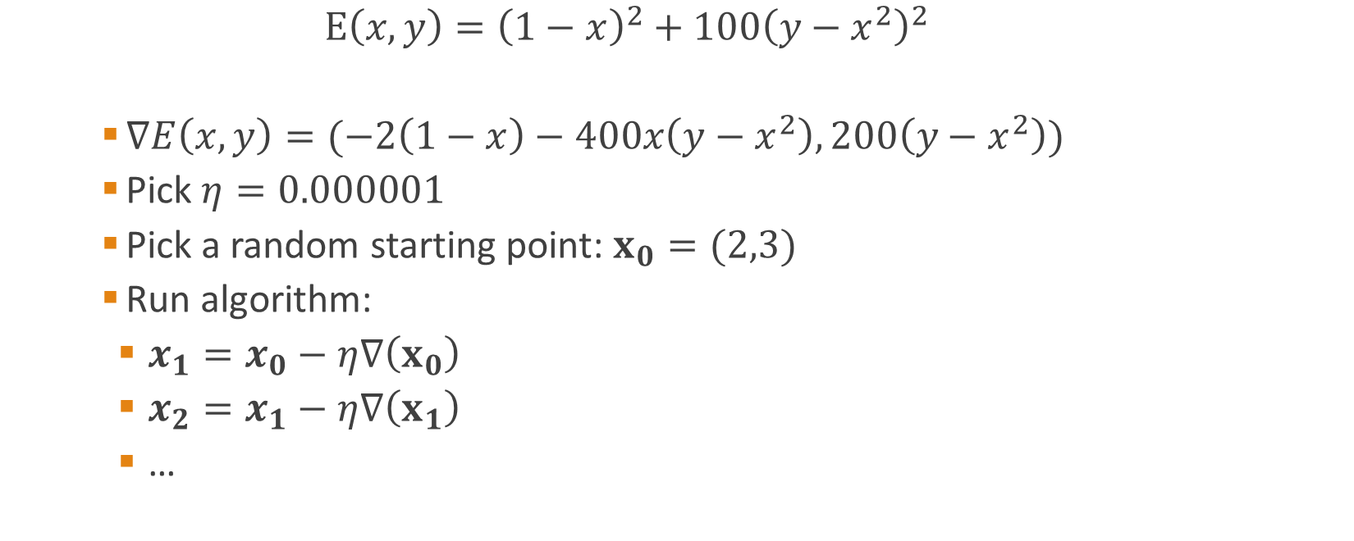
Gradient descent example
$$E\left(x,y\right)={\left(1−x\right)}^{2}+100{\left(y−x^{2}\right)}^{2}$$
$∇E\left(x,y\right)=(−2\left(1−x\right)−400x\left(y−x^{2}\right), 200\left(y−x^{2}\right))$
Pick $η=0.000001$
Pick a random starting point: $x_{0}=(2,3)$
Run algorithm:
$x_{1}=x_{0}−η∇\left(x_{0}\right)$
$x_{2}=x_{1}−η∇\left(x_{1}\right)$
…

Slide 8
Python code (for documentation)
def E(x,y):
return (1-x)**2 + 100*(y-x**2)**2
def grad(x,y):
return [-2*(1-x) -400*x*(y-x**2), 200*(y-x**2)]
vec = [2,3]
eta = 0.000001
iters = 0
limit = 4
while iters < limit:
[x,y] = [vec[0],vec[1]]
newgrad = grad(x,y)
vec = [x - eta*newgrad[0], y - eta*newgrad[1]]
iters += 1
try:
print("Iteration number: ", iters, "\n--- Vector: ", vec, "\n--- E(x,y):", E(vec[0], vec[1]))
except:
print("iteration", iters, "failed")

Slide 9
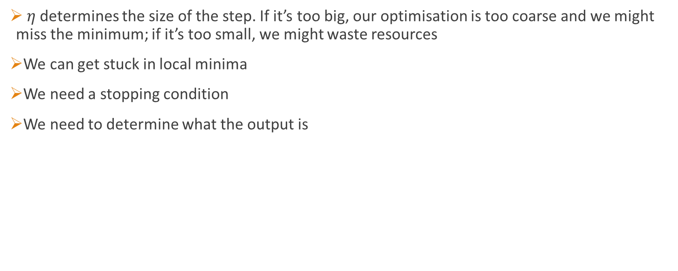
Gradient descent: observations
$η$ determines the size of the step. If it’s too big, our optimisation is too coarse and we might miss the minimum; if it’s too small, we might waste resources
We can get stuck in local minima
We need a stopping condition
We need to determine what the output is

Slide 10
Gradient descent: stopping conditions
After a set number of iterations
When the difference in the output between steps is very small
When the gradient is very small (i.e. approaching a critical point)

Slide 11
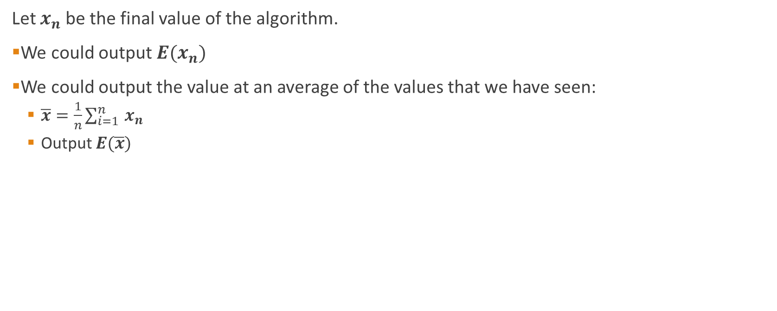
Gradient descent: output
Let $x_{n}$ be the final value of the algorithm.
We could output ${E(x}_{n})$
We could output the value at an average of the values that we have seen:
$\overline{x}=\frac{1}{n}\sum_{i=1 }^{n}{x_{n}}$
Output $E(\overline{x})$

Slide 12
Gradient descent: variations
We could take different step sizes depending on what we discover
We probably want a way to automate out of loops/bad areas
More powerful is stochastic gradient descent
Not possible if we can’t easily calculate the gradient…
… although still possible if the gradient doesn’t exist

Slide 13
Simplex
0-dimensional:
1-dimensional:
2-dimensional:
3-dimensional:
n-dimensional:
convex hull of n+1 linearly independent vertices
i.e. pick n+1 linearly independent vertices (e.g. not all on a line/plane). Find the smallest shape that you can draw with straight lines that contains all points

Slide 14
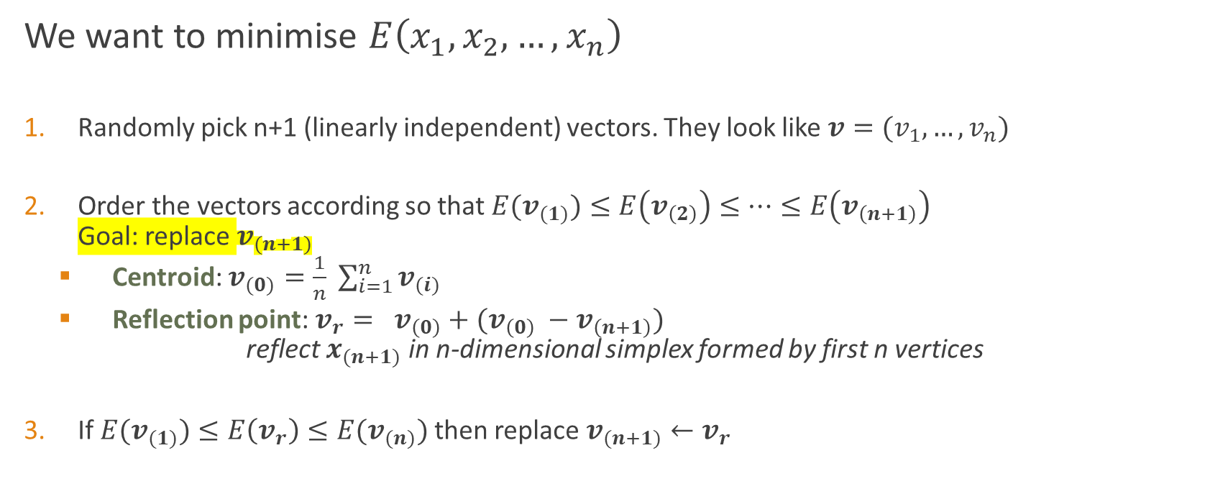
Downhill simplex algorithm/Nelder-Mead
We want to minimise $E\left(x_{1},x_{2}, …,x_{n}\right)$
Randomly pick n+1 (linearly independent) vectors. They look like $v=(v_{1}, …, v_{n})$
Order the vectors according so that ${E(v}_{(1)})≤E\left(v_{\left(2\right)}\right)≤…≤E\left(v_{\left(n+1\right)}\right)$ Goal: replace $v_{(n+1)}$
Centroid: $v_{(0)}=\frac{1}{n} \sum_{i=1}^{n}{v_{(i)}}$
Reflection point: $v_{r}= v_{\left(0\right)}+(v_{\left(0\right)} −v_{\left(n+1\right)})$ reflect $x_{(n+1)}$ in n-dimensional simplex formed by first n vertices
If ${E(v}_{(1)})≤E\left(v_{r}\right)≤E(v_{(n)})$ then replace $v_{(n+1)}←v_{r}$

Slide 15
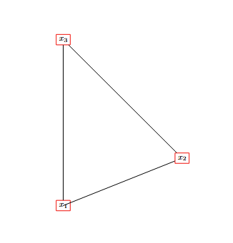
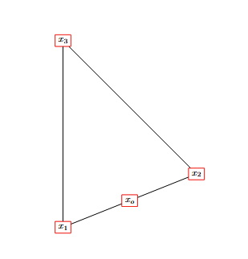
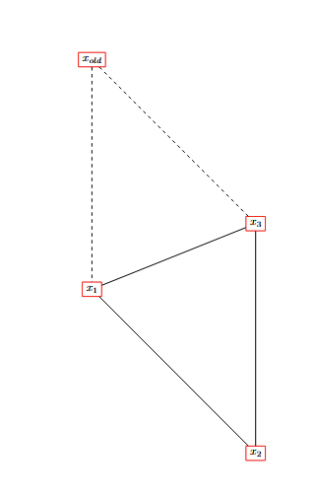
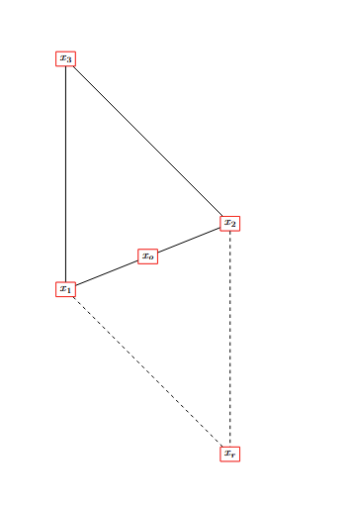
Visually
1. Order points
2. Find centroid. Here it’s the midpoint.
3. Reflection
4. Replace old vertex and reorder points

Slide 16

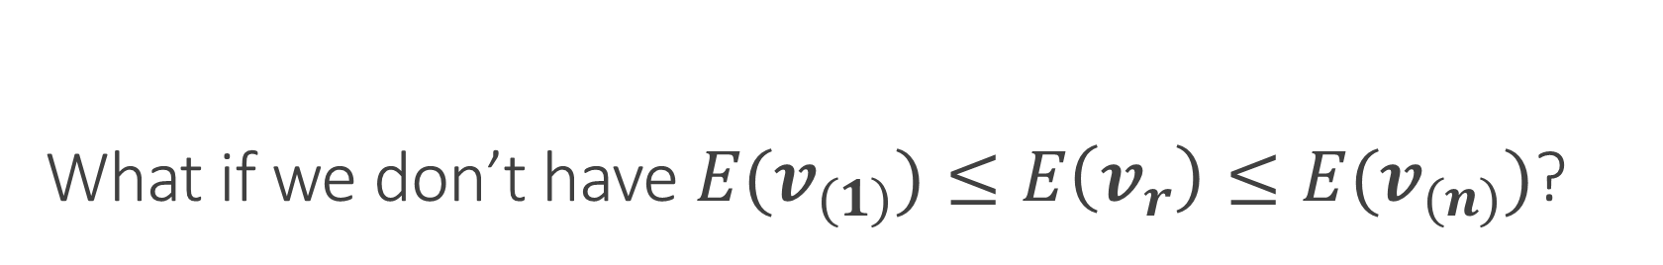
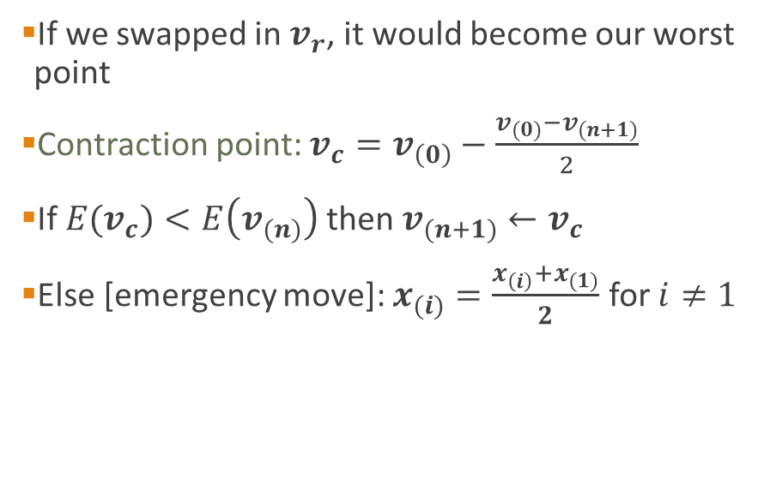

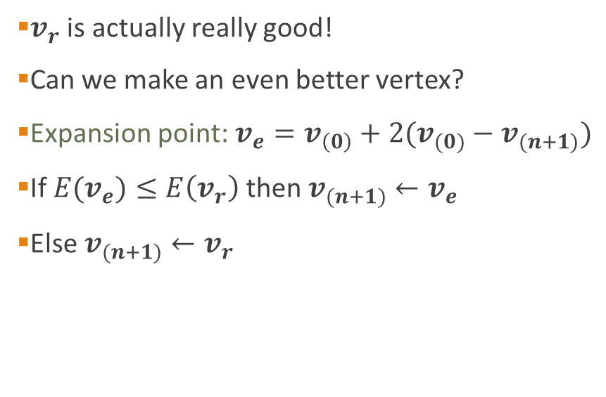
What if we don’t have ${E(v}_{(1)})≤E\left(v_{r}\right)≤E(v_{(n)})$?
$${E(v}_{r})≤E\left(v_{(1)}\right)$$
$$E\left(v_{r}\right)>E(v_{(n)})$$
$v_{r}$ is actually really good!
Can we make an even better vertex?
Expansion point: $v_{e}=v_{\left(0\right)}+2(v_{(0)}−v_{(n+1)})$
If ${E(v}_{e})≤E\left(v_{r}\right)$then $v_{(n+1)}←v_{e}$
Else $v_{(n+1)}←v_{r}$
If we swapped in $v_{r}$, it would become our worst point
Contraction point: $v_{c}=v_{\left(0\right)}−\frac{v_{(0)}−v_{(n+1)}}{2}$
If ${E(v}_{c})<E\left(v_{(n)}\right)$then $v_{(n+1)}←v_{c}$
Else [emergency move]: $x_{(i)}=\frac{x_{\left(i\right)}+x_{(1)}}{2}$ for $i≠1$

Slide 17
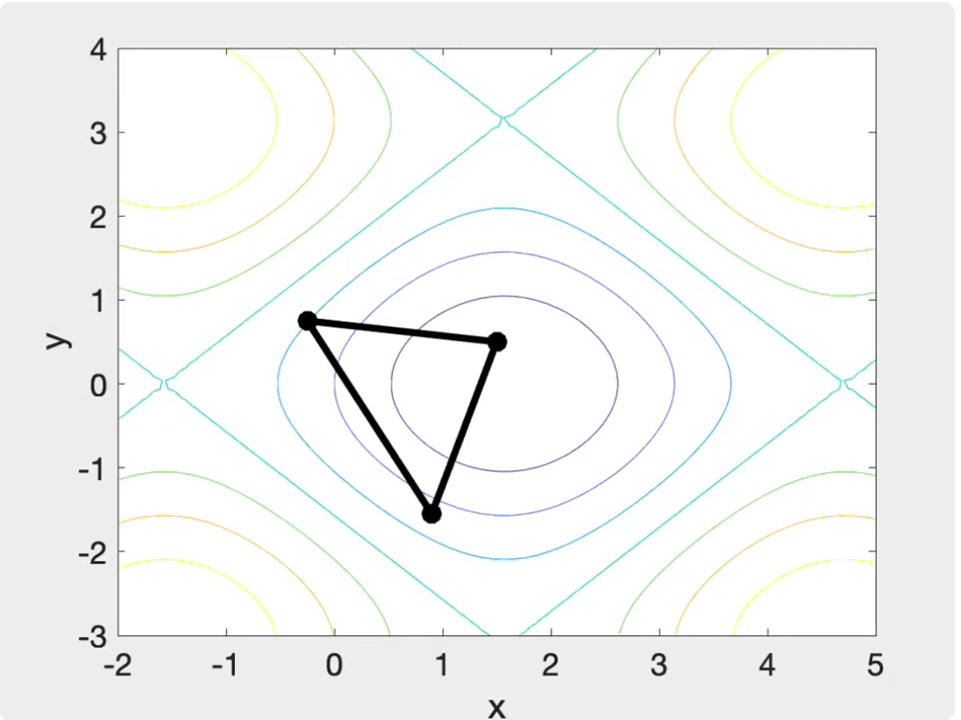
Video
https://www.youtube.com/watch?v=XfdHAcHat7M

Slide 18
Nelder-Mead: when to stop?
When the evaluation of the function at the simplex vertices is `close’
After a maximum number of iterations

Slide 19
Summary
Sometimes calculus is helpful to optimise a function
Gradient descent is useful if the derivative is calculable
Simplex method is always possible, especially if we can’t find the derivative

